Slide 1
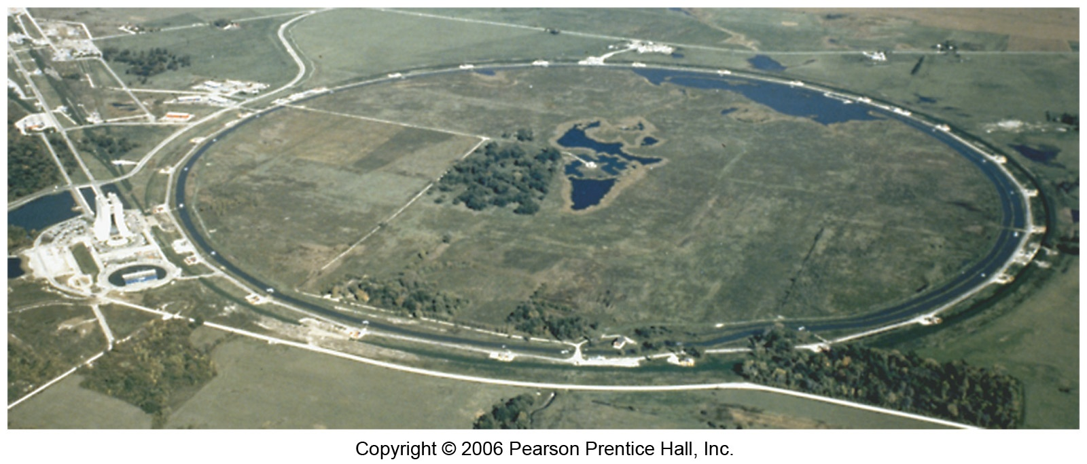
Nuclear Transmutations
Particle accelerators made it possible to synthesize the transuranium elements (elements with atomic number greater than 92).
These particle accelerators are enormous, having circular tracks with radii that are miles long.

Slide 2
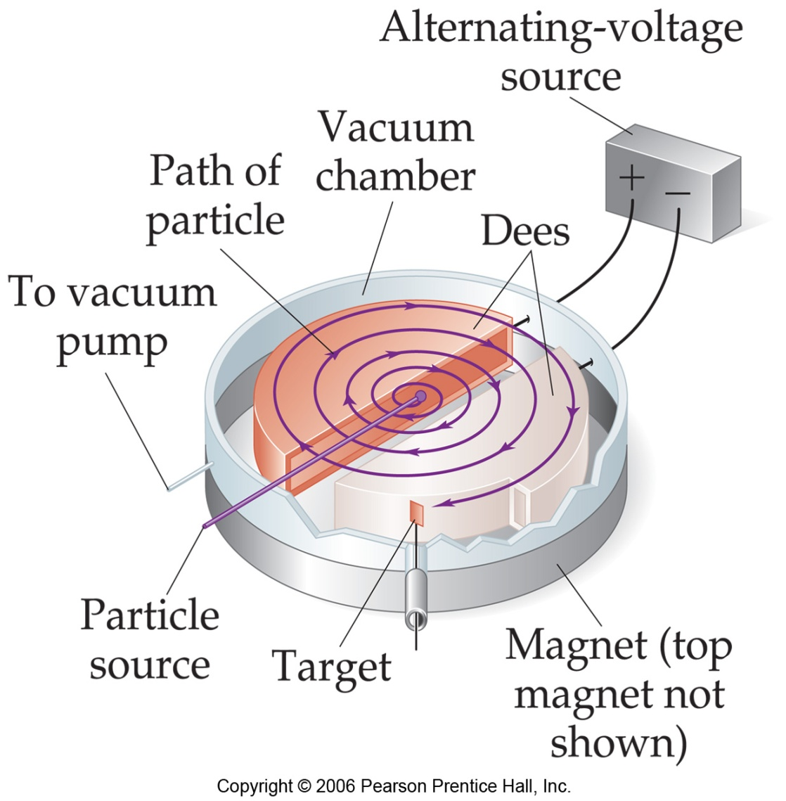
  Nuclear transformations can be induced by accelerating a particle and colliding it with the nuclide.
¹⁴N + ⁴α ¹⁷O + ¹p
7
2
8
1
²⁷Al + ⁴α ³⁰P + ¹n
13
2
15
0
¹⁴N + ¹p ¹¹C + ⁴α
7
1
6
2

Slide 3
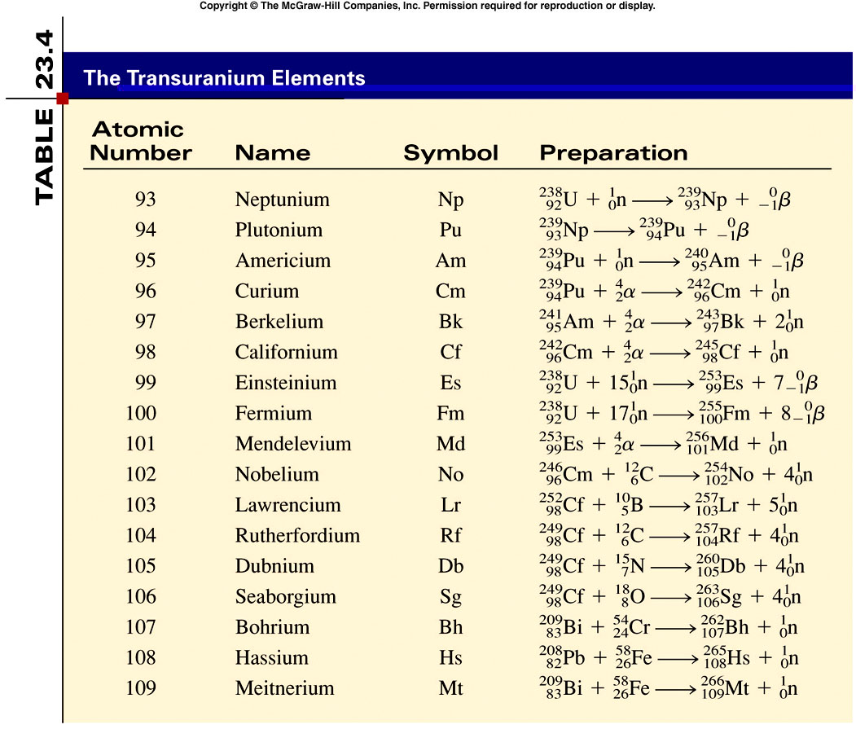
23.4

Slide 4
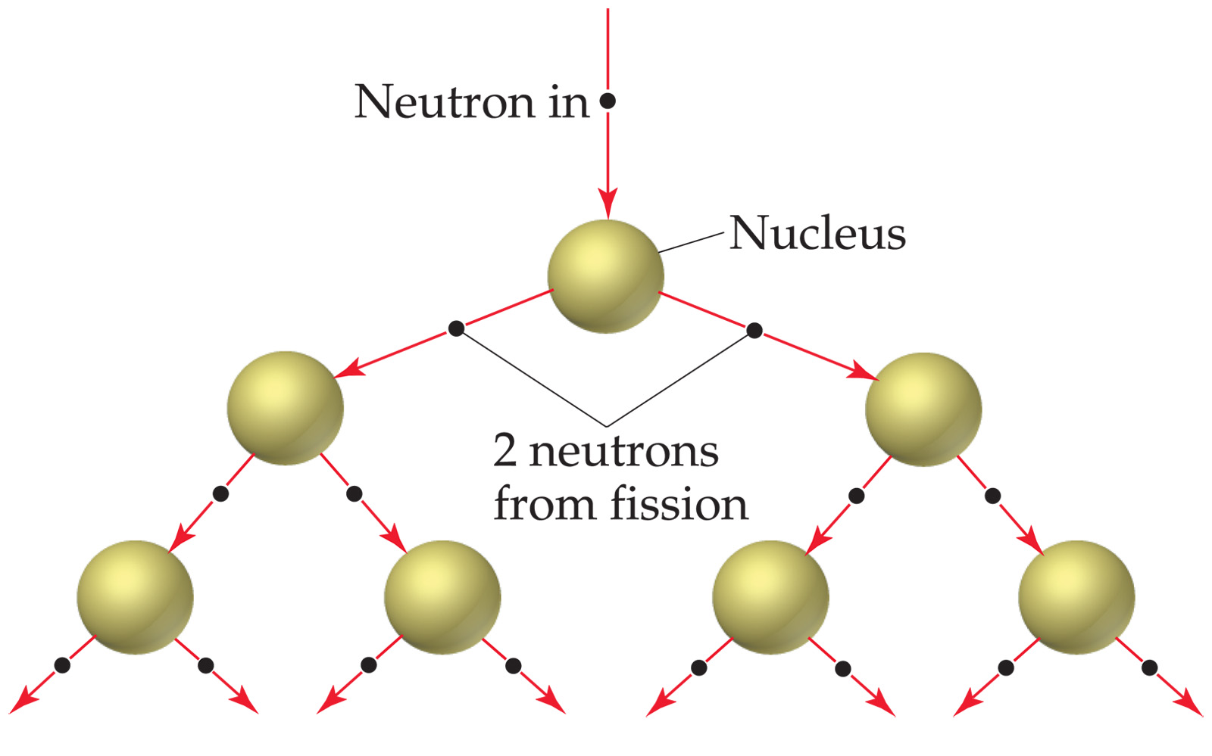
Nuclear Fission
Bombardment of the radioactive nuclide with a neutron starts the process.
Neutrons released in the transmutation strike other nuclei, causing their decay and the production of more neutrons.
This process continues in what we call a nuclear chain reaction.

Slide 5
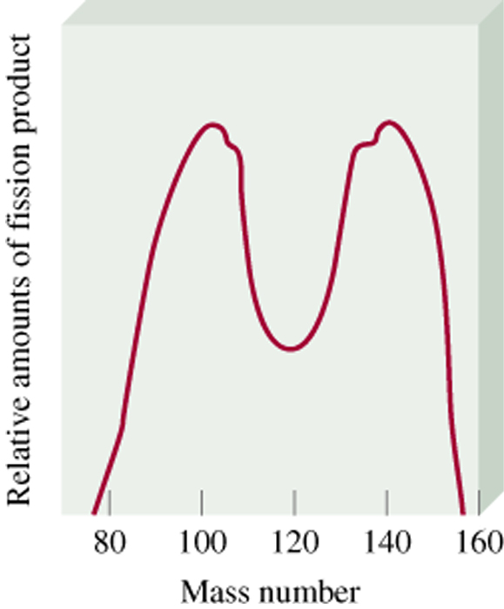
Nuclear Fission
Representative fission reaction
²³⁵U + ¹n ⁹⁰Sr + ¹⁴³Xe + 3¹n + Energy
92
0
38
54
0
23.5

Slide 6

Nuclear chain reaction is a self-sustaining sequence of nuclear fission reactions.
Therefore, there must be a certain minimum amount of fissionable material present for the chain reaction to be sustained: Critical Mass.
Critical Mass is the minimum mass of fissionable material required to generate a self-sustaining nuclear chain reaction.
If there are not enough radioactive nuclides in the path of the ejected neutrons, the chain reaction will die out.

Slide 7
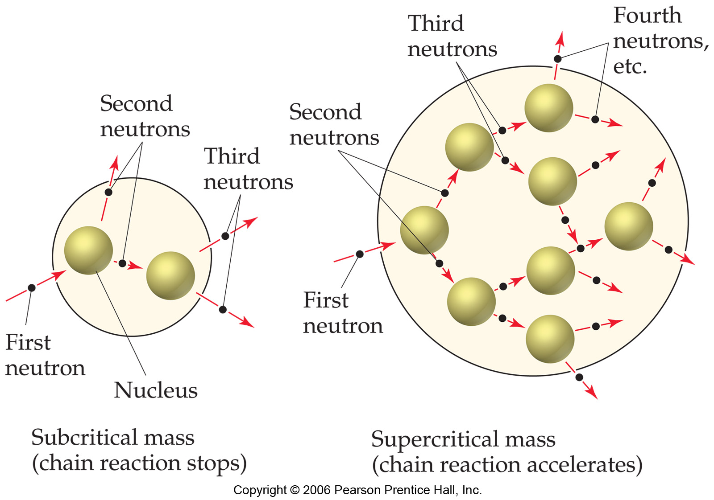
Nuclear Fission

Slide 8
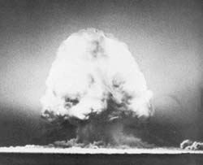
Application of Nuclear Fission:
The Atomic Bomb

Slide 9
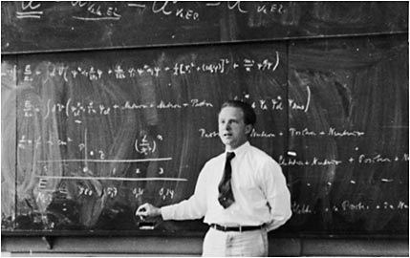
Development of the Atomic Bomb
At the beginning of WW2 Germany had a head start under the guidance of the physicist Werner Heisenberg

Slide 10
Development of the Atomic Bomb
Using heavy water (D₂O) Heisenberg managed to slow neutrons even more than with regular water (H₂O).
British commandos sabotaged the heavy water production facility in Norway and later sunk a ferry transporting heavy water to Germany.
During WW2 the American set up a secret project called the “Manhattan Project” recruiting all the best physicists and nuclear chemists available.
By 1945 they developed two types of nuclear bombs: a U-235 fission bomb and a Pu-239 fission bomb.

Slide 11
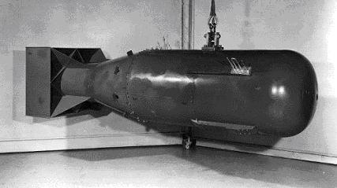
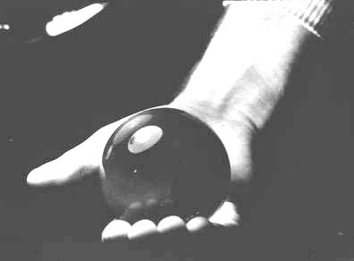
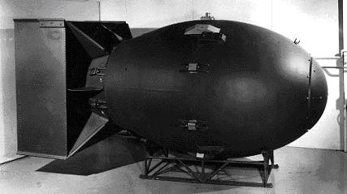
Little Boy and Fat Man
10 feet
Size of Pu core of Nagasaki bomb
Power = 22,000 tons TNT

Slide 12
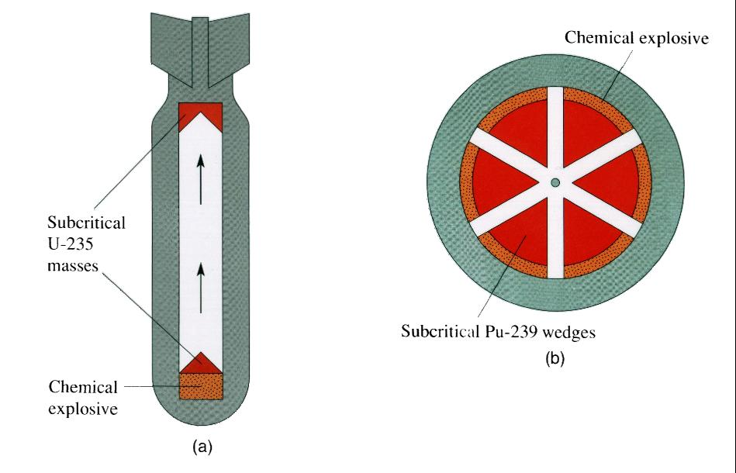
Schematics of an atomic bomb
When two SUBCRITICAL masses are forced together to form a CRITICAL mass...

Slide 13
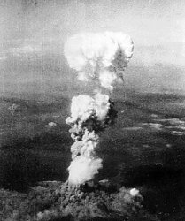
Little Boy – Hiroshima, August 6, 1945
U-235 bomb

Slide 14
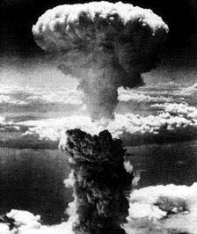
Fat Man – Nagasaki, Aug 9, 1954
Pu-239 bomb

Slide 15
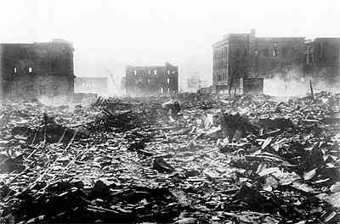

Slide 16
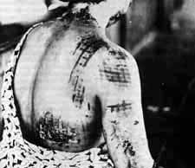

Slide 17
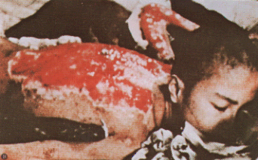

Slide 18
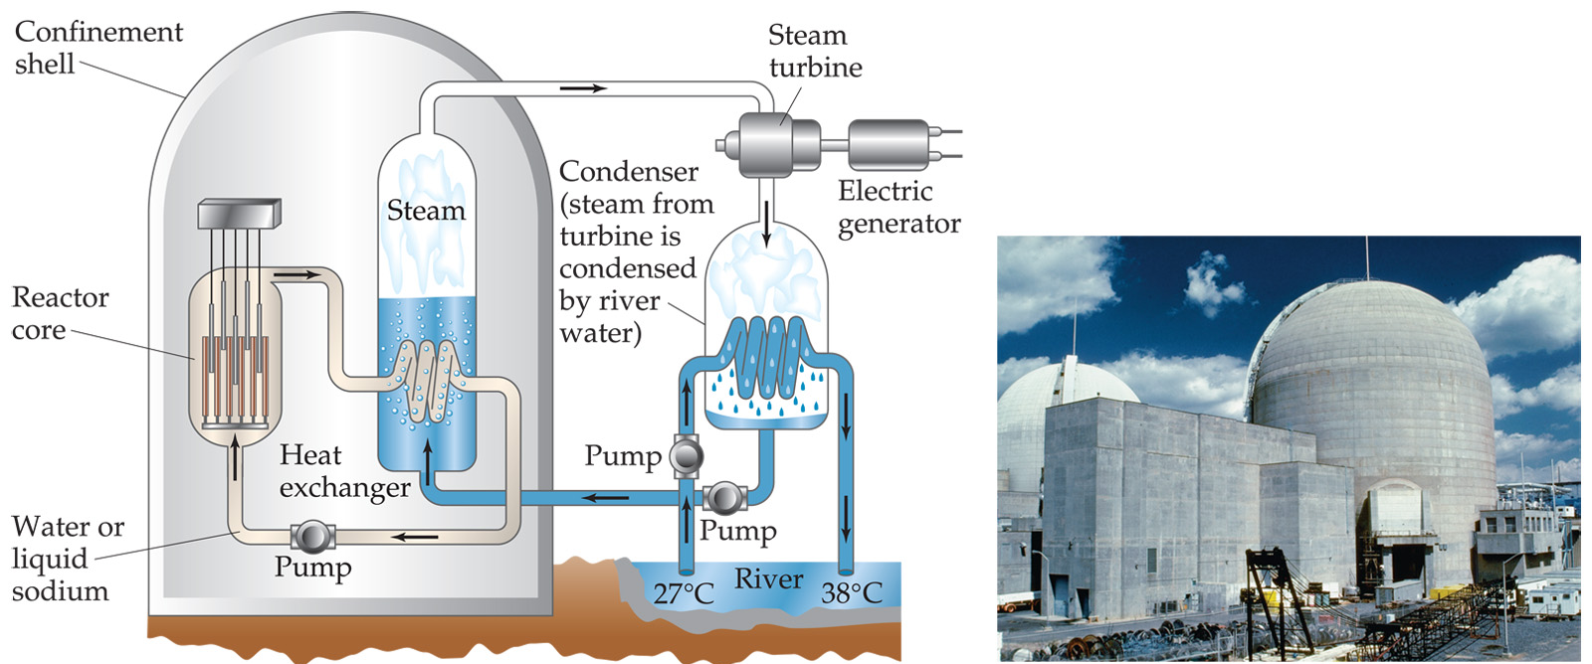
Application of Nuclear Fission:
Nuclear Reactors
In nuclear reactors the heat generated by the reaction is used to produce steam that turns a turbine connected to a generator.

Slide 19
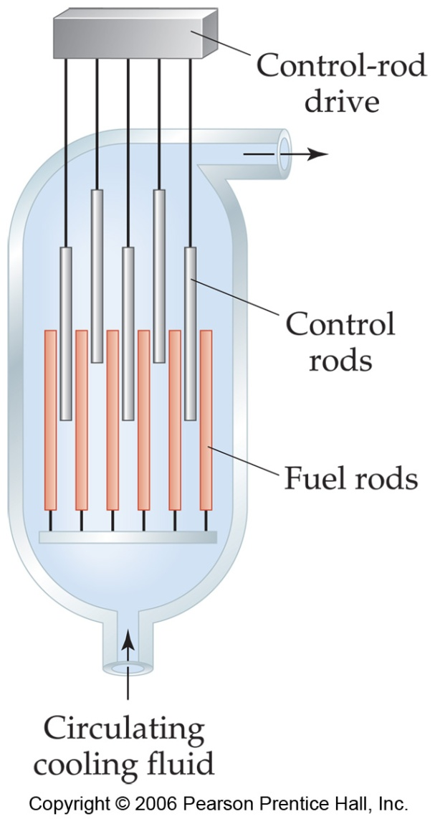
Application of Nuclear Fission:
Nuclear Reactors
The reaction is kept in check by the use of control rods (cadmium or boron rods).
These block the paths of some neutrons, keeping the system from reaching a dangerous supercritical mass.

Slide 20
Nuclear Fission
35,000 tons SO₂
4.5 x 10⁶ tons CO₂
Annual Waste Production
70 ft³ vitrified waste
3.5 x 10⁶
ft³ ash
1,000 MW coal-fired
power plant
1,000 MW nuclear
power plant
23.5

Slide 21
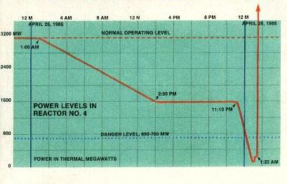
Hazards of nuclear energy
Nuclear accidents – Chernobyl, a reactor at the nuclear plant in Ukraine went out of control.

Slide 22
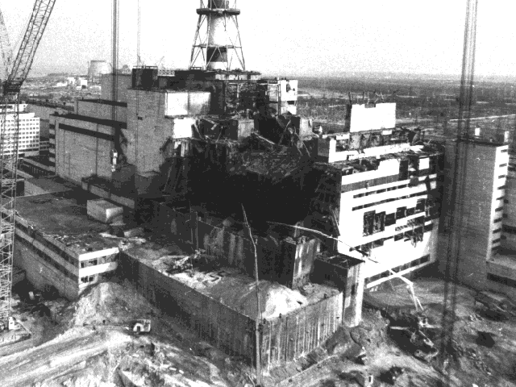
Chernobyl - Reactor 4 After the explosion

Slide 23
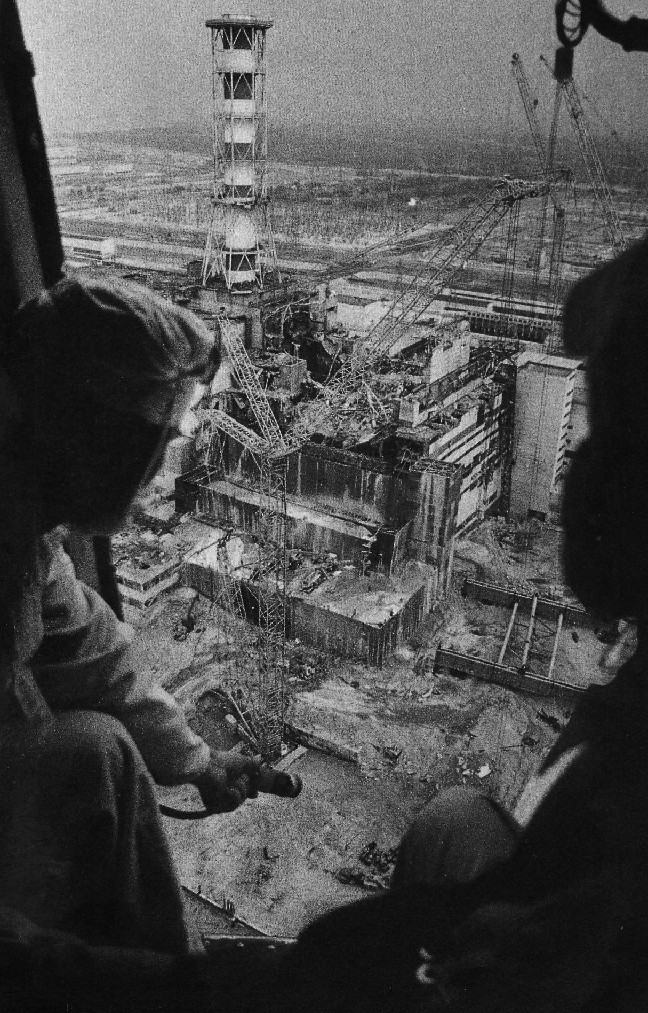

Slide 24

Radiation Burns
30 direct casualties resulted from the accident (plant operators and firefighters).
Radiation released from Chernobyl was 200 times the amount of radiation released at Hiroshima + Nagasaki.

Slide 25
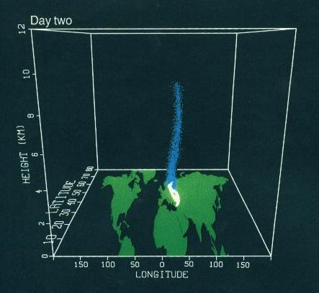
Radioactive Plume - Day 2

Slide 26
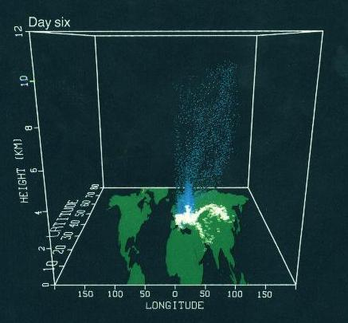
Radioactive Plume - Day 6

Slide 27
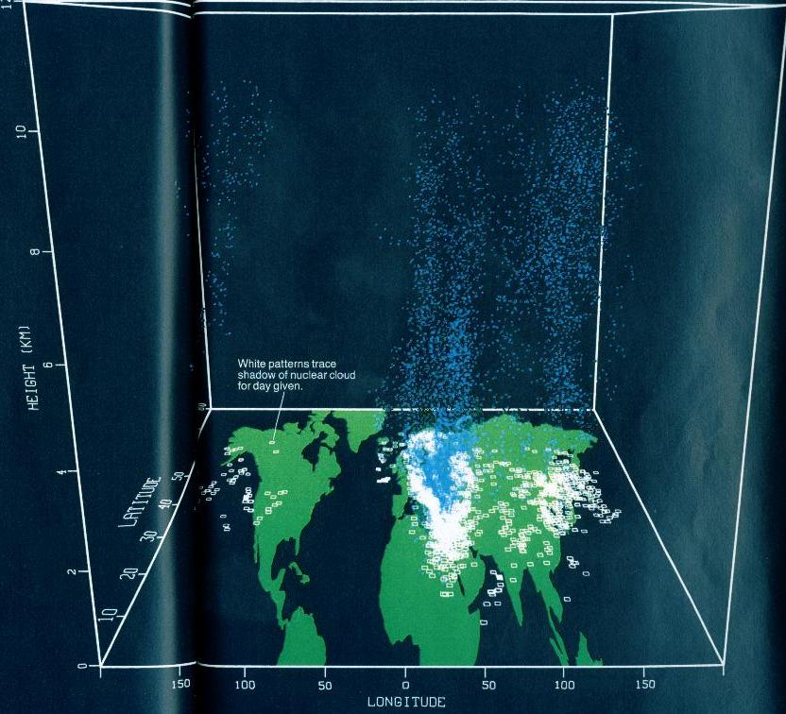
Radioactive Plume - Day 10

Slide 28
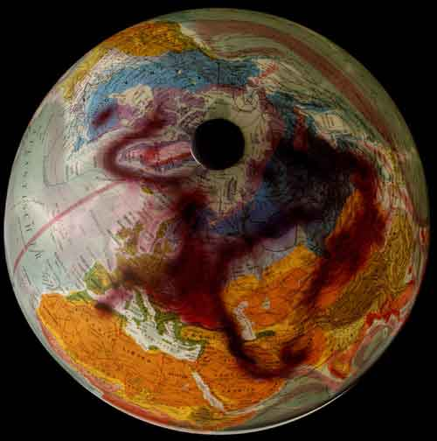

Slide 29


Hazards of nuclear energy
Shaft
Surface
deposits
Other hazards:
Nuclear waste disposal;
Uranium mining;
Nuclear terrorism.
Aquifier
River
Interbed
rock layer
Host rock
formation
Repository
Waste
package
Interbed
rock layer
Waste
form
Aquifier
Bedrock

Slide 30
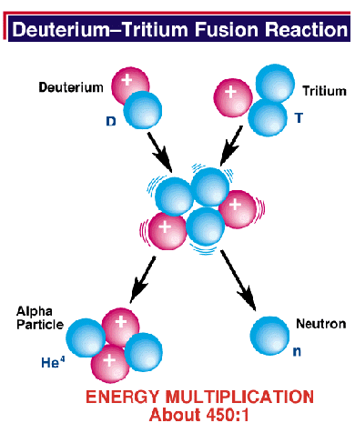
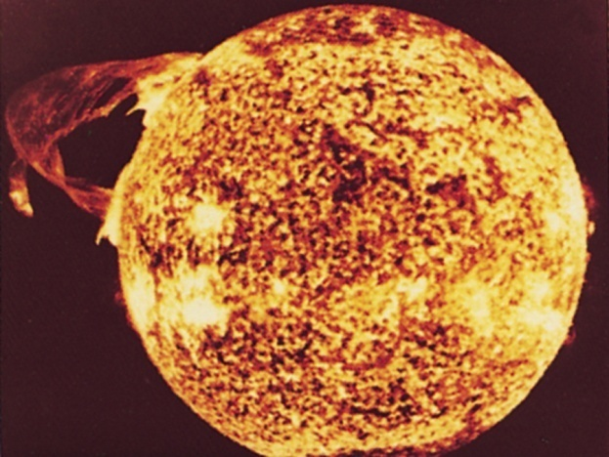
Nuclear Fusion
combining of two nuclei to form one nucleus of larger mass.
thermonuclear reaction – requires temp of 40,000,000 K to sustain.
1 g of fusion fuel = 20 tons of coal.
occurs naturally in star.

Slide 31
Fusion would be a superior method of generating power:
  The good news is that the products of the reaction are not radioactive.
  The bad news is that in order to achieve fusion, the material must be in the plasma state at several million Kelvins. Attempt of ‘cold fusion’ have failed and ‘hot fusion’ is difficult to contain.
  Tokamak apparatus shows promise for carrying out these reactions.
  Magnetic fields are used to heat the material.

Slide 32
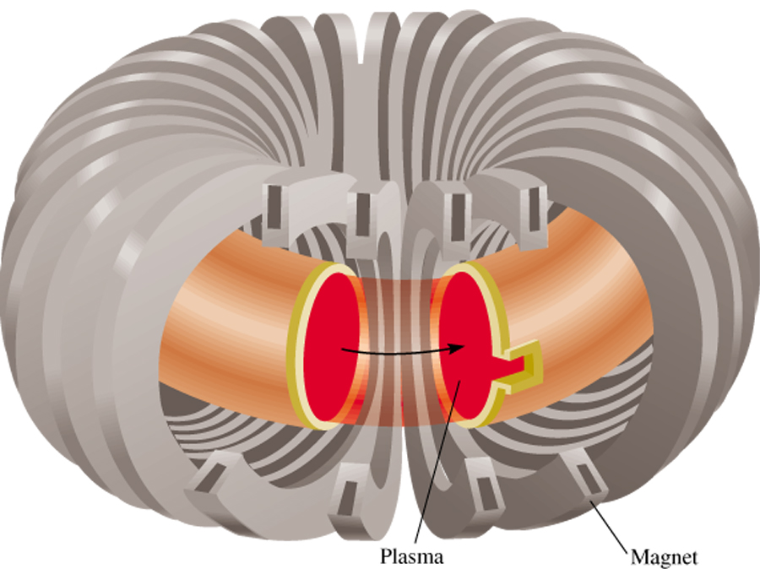
Nuclear Fusion
Fusion Reaction
Energy Released
²H + ²H ³H + ¹H
6.3 x 10⁻¹³ J
1
1
1
1
²H + ³H ⁴He + ¹n
2.8 x 10⁻¹² J
1
1
2
0
⁶Li + ²H 2 ⁴He
3.6 x 10⁻¹² J
3
1
2
Tokamak magnetic plasma confinement
(plasma = gaseous mixture of positive ions and electrons)
23.6

Slide 33
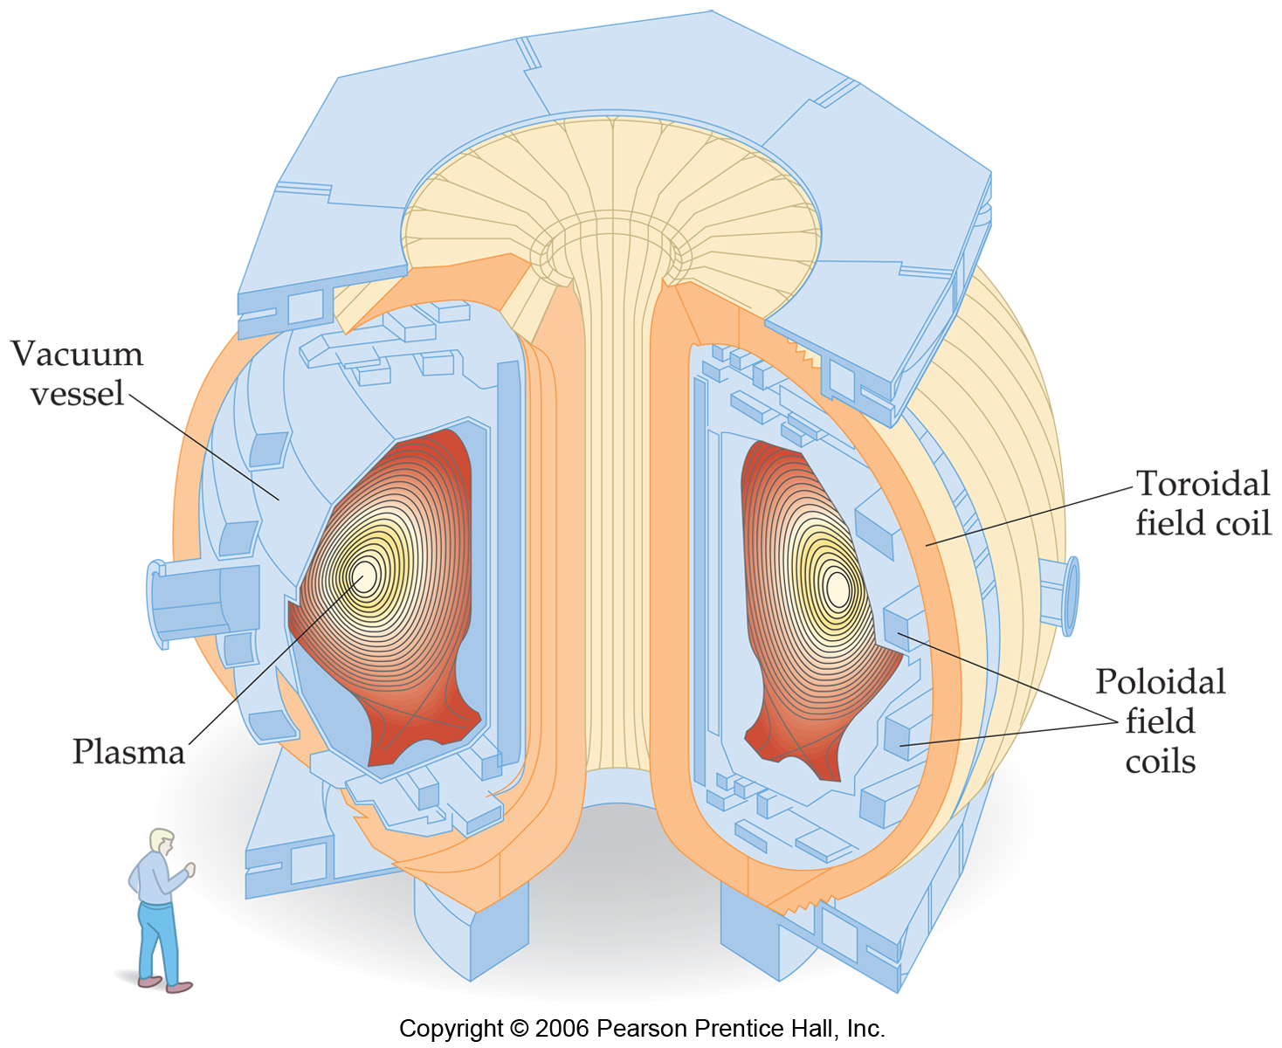
Tokamak magnetic plasma confinement

Slide 34
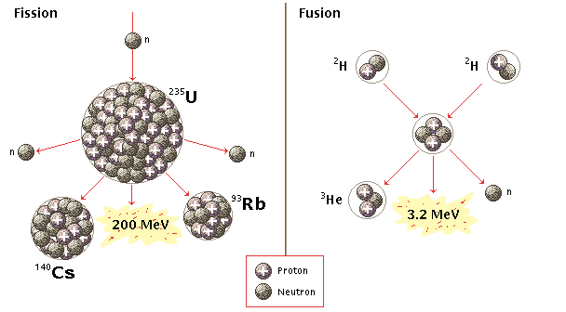
Fission vs. Fusion
fuel is abundant
no danger of meltdown
no toxic waste
not yet sustainable (meeting the needs of the present without compromising the needs of future generations)
²³⁵U is limited
danger of meltdown
toxic waste
thermal pollution (temperature change in natural water bodies caused by human influence)

Slide 35
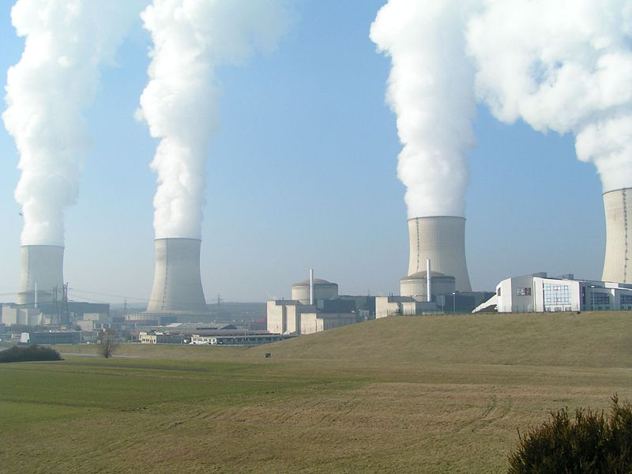
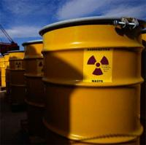
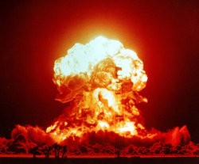
Nuclear power produces needed energy, but nuclear waste threatens our future.
Nuclear weapons make us strong, but dirty bombs make us vulnerable.

Slide 36
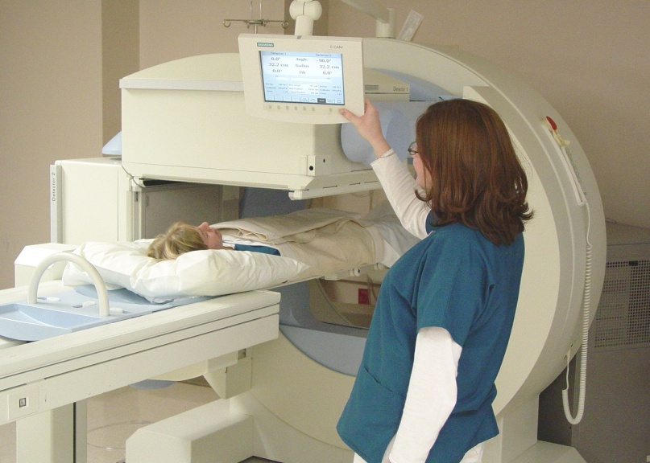


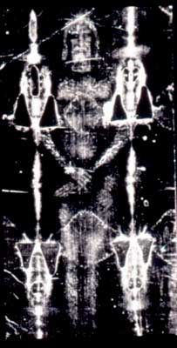
Nuclear medicine heals us, but nuclear radiation sickens us.
Radio-carbon dating tells us about the past, but challenges our religious faith.

